Slide 1
Computer Communication Networks (CMP 206)
Compiled by
Egena Onu, Ph.D.

Slide 2
Physical Layer
The physical layer interfaces the hardware and the signalling mechanism.
This is the only layer of the OSI model that handles connectivity for all connected devices,
The physical layer defines the hardware equipment, cabling, wiring, frequencies, pulses used for binary signals, etc.

Slide 3
Physical Layer
This layer provides services to the data-link layer.
The physical layer converts frames from the data-link layer into electrical pulses (binary data).
The binary data is then sent over the wired or wireless media.

Slide 4
Physical Layer
Signals
Signal is an electrical pulse that moves through a wire in the form of voltage.
When data is sent over a physical medium, it is first converted into electromagnetic signals.
The data itself can be analog such as the human voice, or digital such as a file on a computer.
Both analog and digital data can be represented in digital or analog signals.
Digital signals are discrete in nature and represent a sequence of voltage pulses.
Digital signals are used within the circuitry of the computer.
Analog signals are in continuous wave form in nature and represented by continuous electromagnetic waves.
Notes:
A signal is an electrical pulse (0s and 1s) that move through a wire in the form of voltage
Data can be analog(human voice) or digital(file on computer)
Both data must be represented in there signals in order to enable communication
Digital signals are discrete in nature and represent a sequence of voltage pulses.
Analog signals are in continuous wave form in nature and represented by continuous electromagnetic waves.

Slide 5
Physical Layer
Signal
When a signal travels through the medium, it tends to deteriorate. This may be as a result of factors such as:
Attenuation
For a receiver to interpret the data accurately, the signal must be sufficiently strong.
When the signal passes through the medium, it tends to get weaker.
As it covers longer distance, it loses strength.
Dispersion
As signal travels through the media, it tends to spread and overlap.
The amount of dispersion depends on the frequency been used.
Delay Distortion
Signals are sent on a medium with predefined speed and frequency.
If the signal speed and frequency do not match, there are possibilities that the signal reaches destination in arbitrary fashion.
In digital media, it is very critical that some bits reach earlier than the previously sent ones.
Notes:
Attenuation – for data to be interpreted accurately it needs to be sufficiently strong
Dispersion – as signals travel through a media it tends to spread and overlap
Delay Distortion – signals are sent with predefined speed and frequency
Noise – is a random disturbance in a digital or analog signal

Slide 6
Physical Layer
Signal
Noise
Noise is a random disturbance or fluctuation in analog or digital signal.
Noise may distort the original information in transmission.
Noise is characterised as follows:

Slide 7
Physical Layer
Signal
Noise
Characteristics of Noise:
Thermal Noise
Heat agitates the electronic conductors of a medium thereby introducing noise to the media.
To a great extent, thermal noise is unavoidable.
Intermodulation
When multiple frequencies share a medium, their interference can cause noise in the medium.
Intermodulation noise occurs if two different frequencies share a medium and one of them has excessive strength or the component itself is not functioning properly, then the resultant frequency may not be delivered as expected.
Notes:
Thermal Noise – heat agitates the conductor introducing noise to the media
Intermodulation – when multiple frequencies share a medium they tend to overlap
Crosstalk – when foreign signals enter into media
Impulse – this occurs due to irregular disturbances

Slide 8
Physical Layer
Signal
Noise
Characteristics of Noise
Crosstalk
Crosstalk happens when a foreign signal enters into the media.
This is because the signal in one medium affects the signal of the second medium.
Impulse
This occurs because of irregular disturbances such lightening, electricity, short-circuit or faulty component.

Slide 9
Physical Layer
Transmission Media
This is the physical media over which information is sent between two connected devices.
There are two forms of transmission media:
Guided Media
In guided media, the sender and the receiver are directly connected and the information is sent (guided) through the media.
All communication wires/cables such as UTP, coaxial cables, and fiber optics are guided media.
Unguided Media
In unguided media, there is no connectivity between the sender an the receiver.
Information is spread over the air and anyone including the recipient may collect the information.
Wireless/open air space is an unguided media.

Slide 10
Physical Layer
Transmission Media
There are different types transmission media:
Magnetic Media
This form of transmission existed long before the concept of networking but it now old fashion.
Information is saved on a physical media then physically moved from one station to another.
Even though it is old fashion, it still plays huge role in data backup in the business communities today.
It saves money when huge amount of data needs to be transferred.
Twisted Pair Cable
A twisted pair cable is made of two plastic insulated copper wires twisted together to form a single media.
One of the two wires only carries the actual signal while the other is used for ground reference.
The twists between wires help to reduce noise (electromagnetic interference) and crosstalk.

Slide 11
Transmission Media
Twisted Pair Cable
There are two types of twisted pair cables:
Shielded Twisted Pair (STP) Cables
These cables are covered in metal foil therefore indifferent to noise and crosstalk.
Unshielded Twisted Pair (UTP) Cables
These are unlike the STP.
UTP cables are most used twisted pair in computer networks.
UTP has seven categories, each suitable for specific use: Cat-5, Cat-5e and Cat-6 are mostly used today to render a high speed internet.
UTP cables are connected using RJ45.

Slide 12
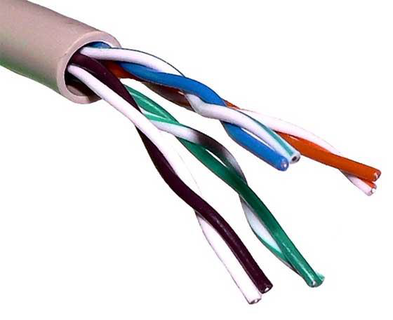
Physical Layer
Transmission Media
Twisted Pair Cable

Slide 13
Physical Layer
Transmission Media
Coaxial Cable
Coaxial cables has two wires of copper.
The core wire lies in the center and it is made of solid conductor.
The core is enclosed in an insulating sheath.
The second wire is wrapped around over the sheath and also encased by an insulator sheath.
All of these are then covered by plastic cover.
Due to its strength, the coaxial cable is capable of carrying high frequency signals than the twisted pair cables.

Slide 14
Physical Layer
Transmission Media
Coaxial Cable
The wrapped structure provides it a good shield against noise and crosstalk.
Coaxial cables provide bandwidth rates up to 450Mbps.
Coaxial cables are connected using BNC and BNC-T connector.
A BNC terminator is used to terminate the wire at the far end.
Coaxial Cables are categorised into three:
RG-59 used for TV transmission.
RG-58 used in Thin Ethernet.
RG-11 used in Thick Ethernet.
RG stands for Radio Government.

Slide 15
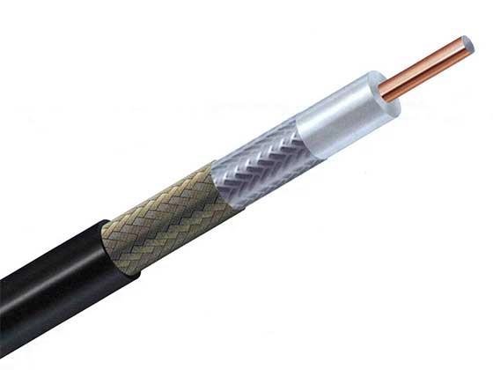
Physical Layer

Slide 16
Physical Layer
Transmission Media
Power Lines
Power Line Communication (PLC) is a Layer-1 technology which uses power cables to transmit data signals.
In PLC, modulated data is sent over the cables.
The receiver on the other end demodulates and interprets the data.
Because power lines are widely deployed, PLC can make all powered devices controlled and monitored.
PLC works in half duplex.

Slide 17
Physical Layer
Transmission Media
Power Lines
There are two types of PLC:
Narrow band PLC
Narrow band PLC provides lower data rates up to 100s of kbps because they work in lower frequencies.
Narrow band PLC can be spread over several kilometres.
Broad band PLC
Broad band PLC provides higher data rates up to 100s of Mbps.
Broad band PLC work at higher frequencies (1.8 – 250 MHz).

Slide 18
Physical Layer
Transmission Media
Fiber Optics
Fiber optics works on the properties of light.
When light ray hits at the critical angle, it tends to refract at 90 degrees.
This property is what fiber optics employs.
From one end, light is emitted and travels through it then it is detected at the other end using light detector.
The light detector detects light stream and converts them into electrical data.
Notes:
Fiber optics uses the property of light
When light hits a critical angle it tends to refract at 90 degrees
From one end light is transmitted through a media and on the other end a light detector is used to interprete the light stream into elect

Slide 19
Transmission Media
Fiber Optics
Fiber optics provides the highest mode of speed.
Fiber optics comes in two modes: single and multi mode.
Single mode carries a single ray of light whereas the multimode carries multiple beams of light.
Fiber optics also comes in unidirectional and bidirectional capabilities.
Fiber optic cables are connected using special connectors: Subscriber Channel (SC), Straight Tip (ST) or MT-RJ

Slide 20
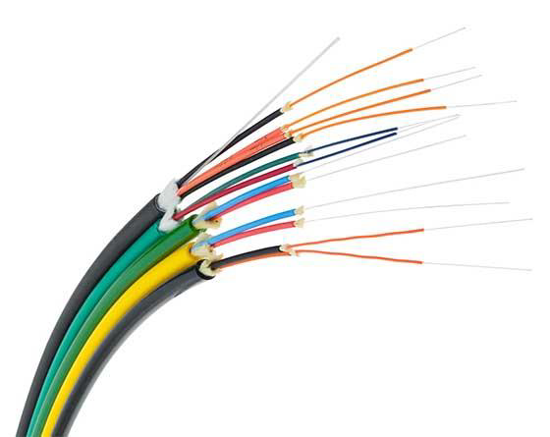
Physical Layer

Slide 21
Physical Layer
Transmission Media
Wireless
Wireless transmission is a form of unguided media.
In the wireless environment, communication involves no physical link established between two or more devices.
Wireless signals are spread over the air and are received and interpreted by appropriate antenna.

Slide 22
Transmission Media
Wireless
When an antenna is attached to electrical circuit of a computer or wireless device, it converts the digital data into wireless signals and spread all over within its frequency range.
The receiver on the other end receives these signals and converts them back to digital data.

Slide 23
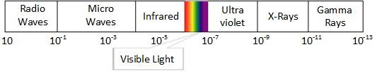
Physical Layer
Transmission Media
Wireless
A little part of electromagnetic spectrum is used for wireless transmission.

Slide 24
Physical Layer
Transmission Media
Wireless
The different wireless transmission media include:
Radio Transmission
Microwave Transmission
Infrared Transmission
Light Transmission

Slide 25
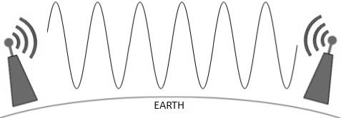
Physical Layer
Transmission Media
Wireless
Radio Transmission
Lower frequencies such as VLF, LF and MF bands can travel on the ground up to 1000 kilometres over the earth surface.
Notes:
Radio Transmission – Radio waves wavelength ranges from 1mm to 100,000km. Radio waves frequency ranges from 3HZ to 300GHZ
Microwave Transmission – (Micro waves above 100MHZ tends to travel on the ground and in a straight line). Microwave’s wavelength ranges from 1mm to 1m and frequencies between 300MHz and 300GHz.
Infrared Transmission – Infrared’s wavelength ranges from 700nm to 1mm and frequency range of 300GHz to 430THz
Light Transmission - Light transmission is realised using LASER(Light Amplification by the Stimulated Emission of Radiation). LASER stimulates atoms or molecules to emit light at particular wavelengths and amplifies that light, producing a very narrow beam of radiation.

Slide 26
Transmission Media
Wireless
Radio Transmission
Radio frequency is easier to generate and because of its large wavelength it can penetrate through walls and structures alike.
Radio waves can have wavelength from 1mm to 100,000km.
Radio waves also have frequency ranging from 3Hz (extremely low frequency) to 300GHz (extremely high frequency).

Slide 27
Transmission Media
Wireless
Radio Transmission
Radio frequencies are sub-divided into six bands
Radio waves lower frequencies can travel through walls where higher RF can travel in straight line and bounce back.
High frequency radio waves have more power.
The power of low frequency waves decreases sharply as they cover long distances.

Slide 28
Physical Layer
Transmission Media
Wireless
Radio Transmission
Radio waves of high frequencies are open to be absorbed by rain and other obstacles.
These radio waves use Ionosphere of the earth’s atmosphere.
High frequency radio waves such as HF and VHF bands are spread upwards.
When they reach the Ionosphere, they are refracted back to earth.

Slide 29
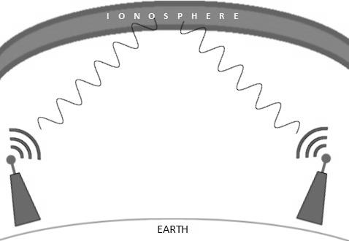
Physical Layer
Transmission Media
Wireless
Radio Transmission

Slide 30
Physical Layer
Transmission Media
Wireless
Microwave Transmission
Electromagnetic waves above 100MHz tend to travel in a straight line and signals over them can be sent by beaming those waves towards one particular station.
Since microwaves travel in straight lines, both sender and receiver must align in strictly line-of-sight fashion.
Microwaves have wavelength ranging from 1mm to 1m and frequencies between 300MHz and 300GHz.

Slide 31
Transmission Media
Wireless
Microwave Transmission
Microwave antennae concentrate the waves making a beam of it.
As shown in the figure on the next slide, multiple antennae can be aligned to reach further.
Microwave have higher frequencies and do not penetrate wall like obstacles.
Microwave transmission depends highly upon weather conditions and the frequency it is using.

Slide 32
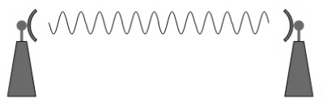
Physical Layer
Transmission Media
Wireless
Microwave Transmission

Slide 33
Physical Layer
Transmission Media
Wireless
Infrared Transmission
Infrared wave lies between visible light spectrum and microwaves.
Infrared has wavelength of 700nm to 1mm and frequency range of 300GHz to 430THz.
Infrared wave is used for very short range communication purposes such as television remotes.
Infrared travels in a straight line, hence it is directional by nature.
Due to the high frequency, infrared cannot go through wall-like obstacles.

Slide 34
Physical Layer
Transmission Media
Wireless
Light Transmission
Light transmission is realised using LASER.
LASER stands for “Light Amplification by the Stimulated Emission of Radiation”.
LASER stimulates atoms or molecules to emit light at particular wavelengths and amplifies that light, typically producing a very narrow beam of radiation.
The emission generally covers an extremely limited range of infrared, or ultraviolet wavelengths.

Slide 35
Transmission Media
Wireless
Light Transmission
LASER is the highest most electromagnetic spectrum which can be used for data transmission when done through light or optical signalling.
Because of its high frequency, it tends to travels strictly in straight line.
Because LASER transmission is unidirectional, at both ends of the communication, there is need to install a photo-detector.
LASER beam is generally 1mm wide therefore making it a work of precision to align two far receptors each pointing to a LASER source.

Slide 36
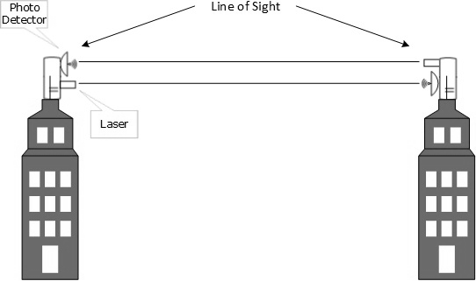
Physical Layer
Transmission Media
Wireless
Light Transmission

Slide 37
Physical Layer
Transmission Media
Wireless
Light Transmission
LASER cannot penetrate obstacles such as walls, rain, and thick fog.
LASER beam is distorted by wind, atmosphere temperature, or a variation in temperature in the path.
LASER is safe for data transmission as it is very difficult to tap 1mm wide laser without interrupting the communication channel.
As shown in the figure on the next slide, LASER works as the transmitter (Tx) and the photo-detector works as the receiver (Rx).

Slide 38
Physical Layer
Digital Transmission
Data/information is stored in either of ways: analog or digital.
For a computer to use data, it must be in discrete digital form.
Similar to data, signals can also be in analog or digital form.
To transmit data digitally, it needs to be converted to digital form.
Notes:
Digital Transmission is basically the conversion of analog or digital data into digital form for transmission
2 forms data can be stored:
Analog
Digital
Types of Digital Conversion
Digital-to-Digital Conversion
Analog-to-Digital Conversion

Slide 39
Physical Layer
Digital Transmission
Digital-to-Digital Conversion
To be able transmit digital data through a network, it needs to be converted into a digital signal.
This conversion can be done in two ways: line coding and block coding.
Line coding is necessary for all communication whereas block coding is optional.

Slide 40
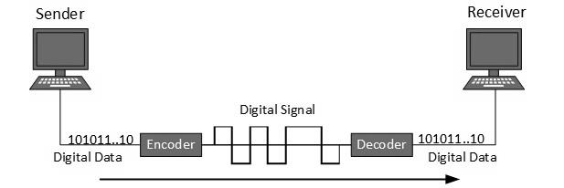
Physical Layer
Digital Transmission
Digital-to-Digital Conversion
Line Coding
Line coding is the process used to convert digital data into digital signal.
Digital data is found in binary format.
This data is represented (stored) internally as a series of 1s and 0s.
The figure below shows what happens when this data is exchanged between two devices.
Notes:
Line coding is the process of converting digital data to digital signal
Block coding is the use of redundant bits to increase accuracy of received data frame

Slide 41
Physical Layer
Digital Transmission
Digital-to-Digital Conversion
Line Coding
Digital signal is denoted by discrete signal which represents digital data.
There are three types of line coding schemes. These include: unipolar, polar and bipolar.

Slide 42
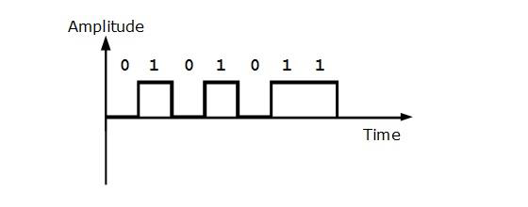
Physical Layer
Digital Transmission
Digital-to-Digital Conversion
Line Coding
Unipolar
Unipolar encoding scheme use single voltage level to represent data.
High voltage is transmitted to represent 1 while 0 is represented by no voltage.
This scheme is also called the Unipolar-Non-return-to-zero because there is no rest condition i.e., it either represents 1 or 0.

Slide 43
Physical Layer
Digital Transmission
Digital-to-Digital Conversion
Line Coding
Polar Encoding
Polar encoding scheme uses multiple voltage levels to represent binary values.
Polar encoding is available in four types:
Polar Non Return to Zero (Polar NRZ)
Return to Zero (RZ)
Manchester
Differential Manchester

Slide 44
Physical Layer
Digital Transmission
Digital-to-Digital Conversion
Line Coding
Polar Encoding
Polar Non Return to Zero (Polar NRZ)
Polar NRZ uses two different voltage to represent binary values.
Positive voltage represents 1 and negative value represents 0.
It is also called NRZ because there is no rest condition.
NRZ scheme has two variants, the NRZ-L and NRZ-I
NRZ-L changes voltage level when a different bit is encountered.
In NRZ-I, when 1 is encountered, the voltage changes.

Slide 45
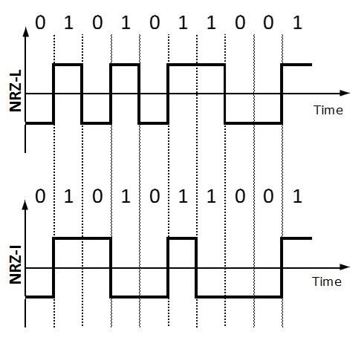
Physical Layer
Digital Transmission
Digital-to-Digital Conversion
Line Coding
Polar Encoding
Polar Non Return to Zero (Polar NRZ)

Slide 46
Physical Layer
Digital Transmission
Digital-to-Digital Conversion
Line Coding
Polar Encoding
Return to Zero (RZ)
The RZ encoding scheme uses three voltage level: positive voltage to represent 1, negative voltage to represent 0 and zero voltage for none.
The problem with RZ is that the receiver cannot conclude when a bit ended and when the next bit is started.

Slide 47
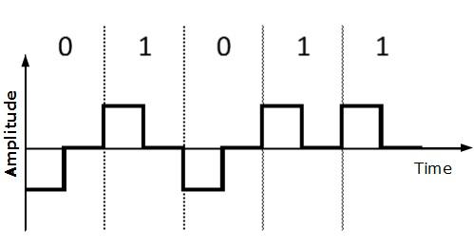
Physical Layer
Digital Transmission
Digital-to-Digital Conversion
Line Coding
Polar Encoding
Return to Zero (RZ)

Slide 48
Physical Layer
Digital Transmission
Digital-to-Digital Conversion
Line Coding
Polar Encoding
Manchester
This encoding scheme is a combination of RZ and NRZ-L.
Bit time is divided into two halves.
It transits in the middle of the bit and changes phase when different bit is encountered.
Differential Manchester
Just like Manchester, this scheme is a combination of RZ and NRZ-I.
It also transits at the middle of the bit but changes phase only when 1 is encountered.

Slide 49
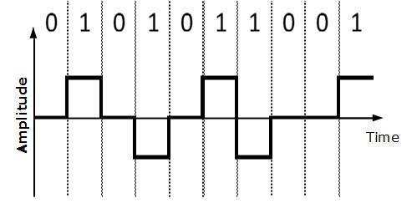
Physical Layer
Digital Transmission
Digital-to-Digital Conversion
Line Coding
Bipolar Encoding
Bipolar encoding uses three voltage levels: positive, negative and zero.
Zero represents binary 0 and 1 is represented by altering positive and negative voltage.

Slide 50
Physical Layer
Digital Transmission
Digital-to-Digital Conversion
Block Coding
Block coding uses redundant bits to ensure the accuracy of received data frame.
For example, in even-parity, one parity bit is added to make the count of 1s in the frame even.
This way, the original number of bits is increased.
Block coding is represented by slash notation, mB/nB. This notation means that m-bit block is substituted with n-bit block where n>m.
Block coding involves three steps:
Division
Substitution
Combination
After block coding is done, it is line coded for transmission.

Slide 51
Physical Layer
Digital Transmission
Analog-to-Digital Conversion
The natural world is mostly surrounded in analog data.
For example, microphones create voice and cameras produce videos which are analog data.
To transmit this data over digital signals, there is need to perform analog to digital conversion.
Analog Data is a continuous stream of data in the wave form whereas digital data is discrete.
To convert analog wave into digital data, Pulse Code Modulation (PCM) is used.
Notes:
Definition
Analog data is a continuous stream of data in its wave form

Slide 52
Physical Layer
Digital Transmission
Analog-to-Digital Conversion
PCM is one of the most commonly used method to convert analog data into digital form.
PCM uses three steps to achieve the conversion:
Sampling
Quantisation
Encoding

Slide 53
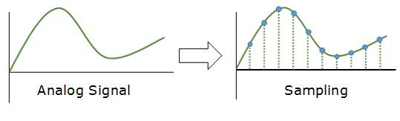
Physical Layer
Digital Transmission
Analog-to-Digital Conversion
Sampling
Sampling yields discrete form of continuous analog signal.
The analog signal is sampled every T interval.
The most important factor in sampling is the rate at which the analog signal is sampled.
According to Nyquist Theorem, the sampling rate must be at least two times the highest frequency of the signal.

Slide 54
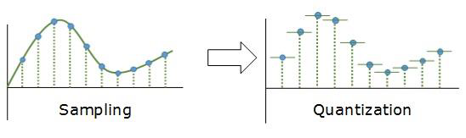
Physical Layer
Digital Transmission
Analog-to-Digital Conversion
Quantisation
As stated earlier, sampling yields discrete form of analog signal.
Every discrete pattern shown the amplitude of the analog signal at that instance.
Quantisation is done between the maximum amplitude value and the minimum amplitude value.
Quantisation is an approximation of the instantaneous analog value.

Slide 55
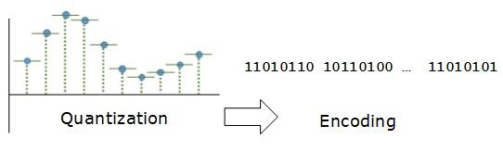
Physical Layer
Digital Transmission
Analog-to-Digital Conversion
Encoding
In encoding, each approximated value is then converted into binary format.

Slide 56
Physical Layer
Digital Transmission
Transmission Mode
Transmission mode decides how data is transmitted between two devices.
The binary data in the form of 1s and 0s can be sent in two different modes: parallel and serial transmission modes.
Notes:
Transmission mode decides how data is transmitted between two devices
There are 2 modes of transmission
Parallel transmission mode
Serial transmission mode

Slide 57
Physical Layer
Digital Transmission
Transmission Mode
Parallel Transmission
In parallel transmission, the binary bits are organised into groups of fixed lengths.
Both sender and receiver are connected in parallel with the equal number of data lines.
Both computers distinguish between high order and low order data lines.
The sender sends all the bits at once on all lines.
Because the data lines are equal to the number of bits in a group, or data frame, a complete group of bits (data frame) is sent in one go.
Parallel transmission has speed as an advantage.
However, the disadvantage is the cost of wires, as it equals to the number of bits sent in parallel.
Notes:
Parallel Transmission
Both sender and receiver are connected in parallel with the equal number of data lines
Sender sends all the bits at once
Has speed advantage
Has cost disadvantage
Serial Transmission

Slide 58
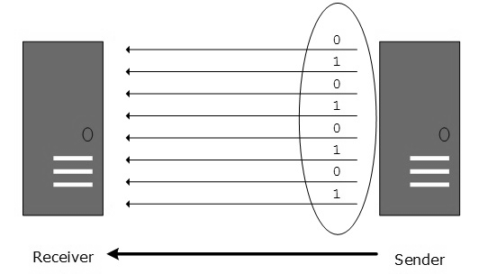
Digital Transmission
Transmission Mode
Parallel Transmission

Slide 59
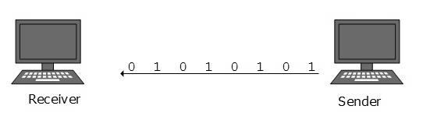
Physical Layer
Digital Transmission
Transmission Mode
Serial Transmission
In serial transmission, bits are sent one after another in a queue.
Serial transmission requires only one transmission line.
Serial transmission can either be asynchronous or synchronous.

Slide 60
Physical Layer
Digital Transmission
Transmission Mode
Serial Transmission
Asynchronous Serial Transmission
This transmission is asynchronous because there is no importance of timing.
Data bits have specific pattern and they help the receiver recognise the start and the end of the data bits.
0 is prefixed on every data and 1 or more 1s are added at the end.
Two continuous data frames (bytes) may have a gap between them.

Slide 61
Physical Layer
Digital Transmission
Transmission Mode
Serial Transmission
Synchronous Serial Transmission
This method of transmission is synchronous because timing is required since there is no mechanism to recognise the start and end data bits.
There is no pattern or prefix/suffix method.
Data bits are sent in burst mode without maintaining gap between bytes (8-bits).
Single burst of data may contain a number of bytes which makes timing very important.
It is up to the receiver to recognise and separate bits into bytes.
The advantage is high speed with no overhead of extra header and footer bits.

Slide 62
Physical Layer
Analog Transmission
To send digital data over an analog media, it needs to be converted into analog signal.
In converting digital data into analog signal, there can be two cases:
Bandpass:
In bandpass, filters are used to filter and pass frequencies of interest.
A bandpass is a band of frequencies which can pass the filter.
Low-pass:
Low-pass is a filter that passes low frequency signals.

Slide 63
Physical Layer
Analog Transmission
When digital data is converted into a bandpass analog signal, is called digital-to-analog conversion.
Same way, when low-pass analog signal is converted into bandpass analog signal, it is called analog-to-analog conversion.

Slide 64
Physical Layer
Analog Transmission
Digital-to-Analog Conversion
When data from one device is sent to another via some analog carrier, it is first converted int analog signals.
Analog signals are modified to reflect digital data.
An analog signal is characterised by its amplitude, frequency, and phase.

Slide 65
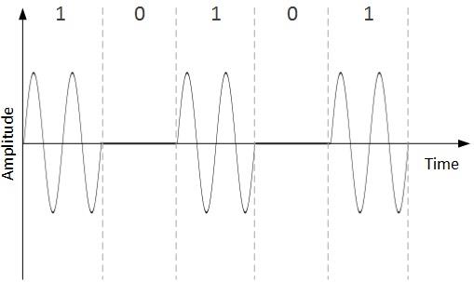
Physical Layer
Analog Transmission
Digital-to-Analog Conversion
There are three kinds of digital-to-analog conversion:
Amplitude Shift Keying (ASK)
In ASK conversion technique, the amplitude of the analog carrier signal is modified to reflect binary data.

Slide 66
Physical Layer
Analog Transmission
Digital-to-Analog Conversion
Amplitude Shift Keying (ASK)
Binary data represents digit 1, therefore the amplitude is held.
Otherwise, it is set to 0.

